Slide 1
Parts of a Computer System

Slide 2

Why do we need to know THE PARTS OF A COMPUTER SYSTEM?

Slide 3
Computer Components
Computer System
Software
Hardware
Input/output
Memory
Processor
Application
System
Notes:
Computer hardware is the group of physical elements that make up a computer system. It represents the actual machine. It consist of tangible or physical components of a computer system that can be felt or touched. Different hardware are linked together to form a functional unit. They are in three parts including Input/output devices, memory and processor. Some of the parts of the computer such as motherboard, graphic cards, keyboard, mouse, monitor and hard drive disk (HDD).
Software is a set of commands (instructions) to manipulate or process data as desired using the computer hardware. They are designed from different programming languages that are either translated or compiled into the format into which the computer hardware can understand. There are two types of software, namely system software and application software.

Slide 4

Operating systems
Most important software of the computer system.
Performs basic functions.
Managing memory, processes, hardware, software.
Converts instructions into bits and bytes.
Coordinates the entire system functionality.
Examples include Windows, Mac OS X and Linux.
Notes:
System software is responsible for the control, management and integration of the individual hardware components of a computer system for users and other software can regard it as a functional unit. Some of this software includes operating system, drivers and file managers.

Slide 5
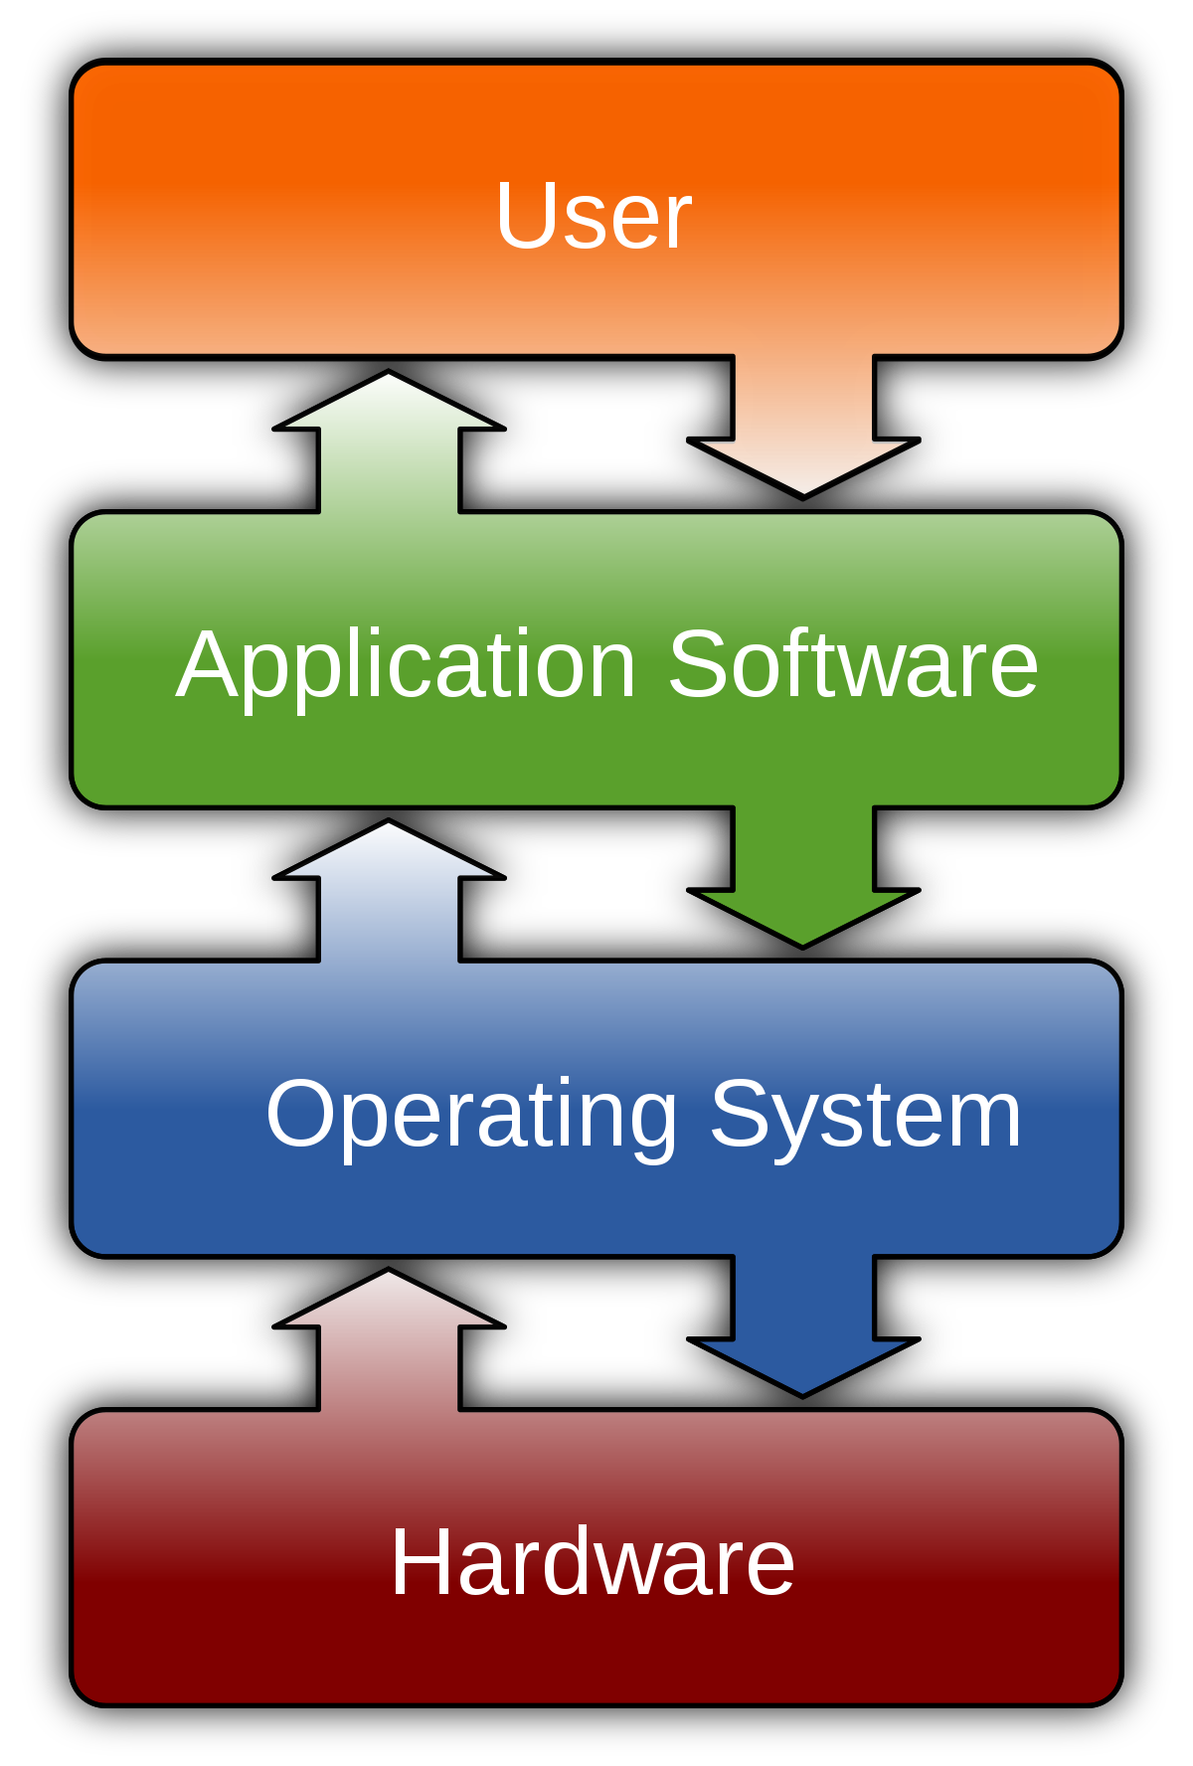
Application Software
Normally designed for the end-user.
utility software: antivirus, disk management, firewall.
Integrated software that works together; e.g., Microsoft Office.
Specific Applications that perform specific functions; e.g., Web Browser, games.
Notes:
Application software are used for specific tasks rather than making the hardware for functioning in a particular manner. They are in three parts including utility software, integrated software and specific application software. Utility are used for managing the computer towards enhancing the improvement and functionality. They function to handle different system specific functions such as virus protection, defragment and restore the computer.
The integrated software are suites that have different applications for different purpose.
The specific software is used to perform only one function by the users. The singular application perform only one specific purpose such as browsing, playing games, and database design.

Slide 6
Block Diagram of a Computer
Central Processing Unit (CPU): ALU, Registers and CU
Input: Mouse, Scanner and Keyboard
Output: Printer, Speaker and Monitor
Memory: RAM, ROM and Hard Drive
Notes:
The block diagram shows the relationship between the input, output and the memory of the computer through the Central Processing Unit (CPU). It is a diagrammatic representation of the entire functioning of the computer system. The arrows show the data flow direction within the computer. The CPU reference and store data in the memory. The CPU can access computer program form the data collected from the input devices and process before passing the result to the output.

Slide 7
Hardware: Input and Output
Input devices are used to accept input and instruction from the user.
Output devices are used to present the result of processed instructions.
Both work through ports and connectors.
Notes:
Input devices are used by the computer system to accept data and control signals from humans. They are peripheral devices that transform data from human understanding format to the one that the computer understands and can process. Numerous devices are used for input including keyboard, touch screen, numeric keypad, microphone, and digital camera.
Output devices are used to present the result of data processing that has been conducted by the computer system. They transform the binary (electronic) signal into a format that human can understand. The output format can be in hard or soft format. Some of the devices include monitor, projector, speaker, plotter and printers.

Slide 8
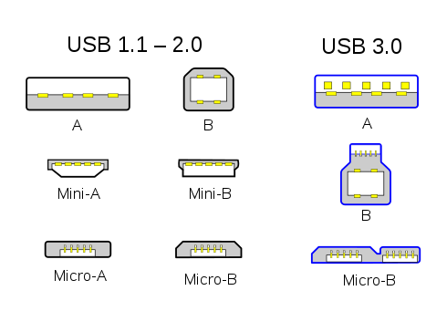
Ports and Connectors
Connectors are attached to devices to connect to the computer system.
Ports are used for plugging the devices into the computer system.
Older ports – parallel, serial.
Modern ports – Universal Serial Bus (USB).
Wireless ports – Bluetooth, Infrared.

Slide 9
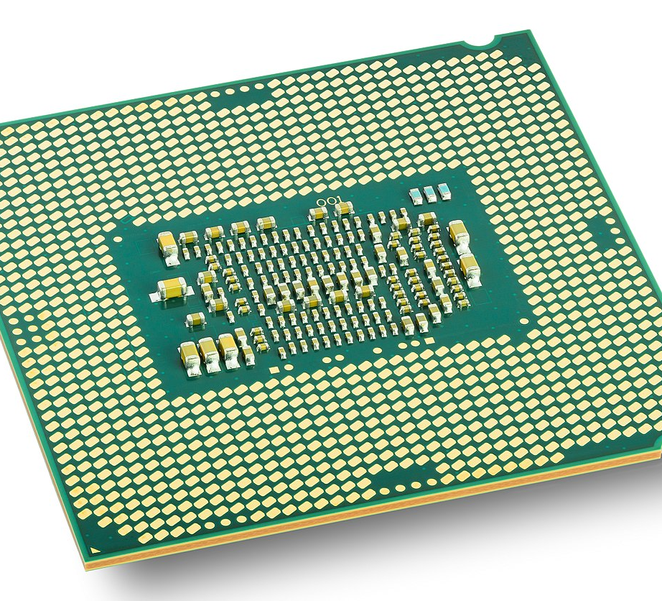
Hardware: Processors
The “brain” of the computer.
Registers act as internal memory of the CPU for temporary data storage.
The control Unit (CU) Passes instructions to ALU.
The Arithmetic and Logic Unit (ALU) performs the arithmetic and logical functions.
Notes:
The Central Processing Unit (CPU) is used for executing instructions that are stored in the main memory. It is regarded as the "brain" of the computer. The CPU requests information from memory. The retrieved information is examined before determining whether it is data or instruction. It contains a program counter (PC). An instruction is determined when the information from memory is retrieved from the location (address) that is pointed by the contents of the PC. If the information is extracted from the location pointed by other registers in the CPU, it amounts to data.

Slide 10
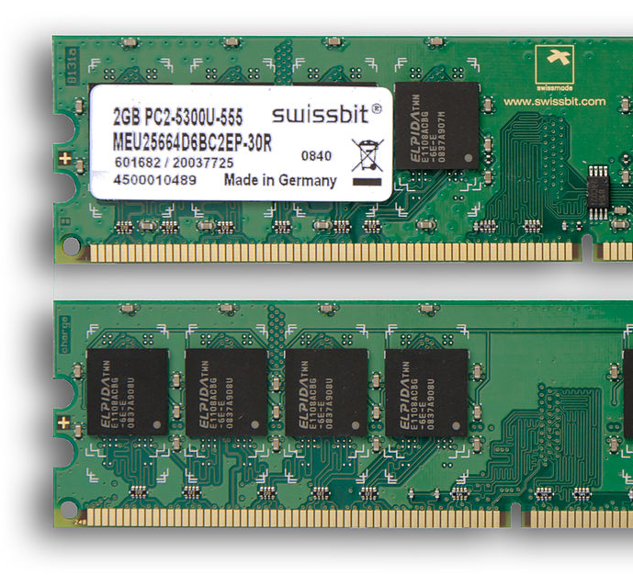
Hardware: Primary Memory
Primary storage unit.
Stores Data and Instructions.
Temporarily Stores Execution Output and Processing.
RAM (Random Access Memory) and ROM (Read Only Memory)
Notes:
Memory in a digital computer is used to store binary information and programs. It is essential because without it, the processors cannot read or write information together with the storage of programs. There are two types of memory and they are primary and secondary memory.
Primary memory is the core computer memory that can be accessed directly by the CPU. They are mainly designed using semiconductor chips and are frequently used to store programs for the CPU to conduct further processing. It is volatile implying that any information inside is temporary. The stored information can be lost in the case of power failure nor subjected to rapid change. It can either be Random Access Memory (RAM) or Read-Only Memory (ROM). RAM allows both read and write operation while ROM only allows read operations. ROM on its part is not volatile.

Slide 11
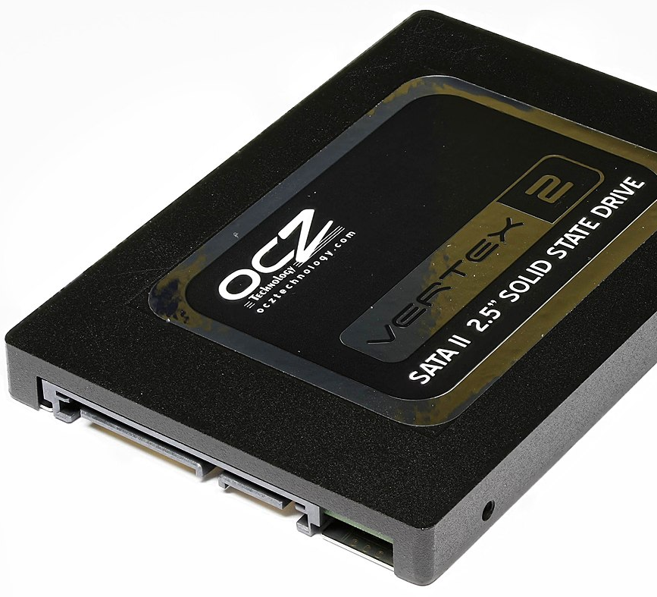
Hardware: Secondary Memory
External Memory to the computer.
Detachable.
Large, Permanent Storage for future Access.
Internal Hard Drive, External hard drive, Sd Card.
Notes:
Primary memories are usually small for the information that is required by a computer system. Hence, the importance of secondary memory. They are external memory that can be deployed for long-term storage of data and information. It is usually referred to as auxiliary memory. It is not volatile and often involves slower data retrieval. When the power is switched off, the data is kept in this memory. Ideally, the CPU does not access secondary memory directly. The data must be copied to the primary memory before CPU can access and process the information. Some of the memory include hard disk, DVD, CD, Flash Drive, and SSD Card.

Slide 12
Memory Units
Memory is stored In Bits.
Either 0 or 1 (off or on).
Common Storage Sizes (SI units):
8 bits = 1 byte (B)
1000 bytes = 1 kilobyte (kB)
1000 kB = 1 megabyte (MB)
1000 MB = 1 gigabyte (GB)
1000 GB = 1 terabyte (TB)
1000 TB = 1 petabyte (PB)
Previously, 1024 was used as an increment (e.g., 1024 MB = 1 GB).
Now new names are being used:
8 bits = 1 byte (B)
1024 bytes = 1 kibibyte (KiB)
1024 KiB = 1 mebibyte (MiB)
1024 MiB = 1 gibibyte (Gib)
1024 GiB = 1 tebibyte (TiB)
1024 TiB = 1 pebibyte (PiB)
Notes:
The unit are used to design the capacity of every memory device. For digital computers, the memory are in bytes. The size of the RAM determines the number of data and program that it can store. The size of the memory is the number its bytes. For example, 24 GB is bigger than 200MB. The increasing processing power and data has made the need for expansion in the size of memory. For example, Personal computers are now having up to 32 GB RAM. The increasing unit measurement is displayed above

Slide 13
In Summary:
A Computer System consists of software and hardware.
Software includes operating systems and application software.
HARDWARE INCLUDES four key components:
Input devices
Output devices
Processor
Memory – primary and secondary.
Original Slides by Pelumi Apantaku
Updated Slides by Kevin Chalmers
Video by Kevin Chalmers
Images Courtesy of Wikimedia

